Slide 1
Statistics with Spa ows
Lecture 11-a
Julia Schroeder
Julia.schroeder@imperial.ac.uk

Slide 2
Outline
Linear models – going big
Categorical predictors

Slide 3
Linear models – different predictors
lm(response~explanatory)

Slide 4
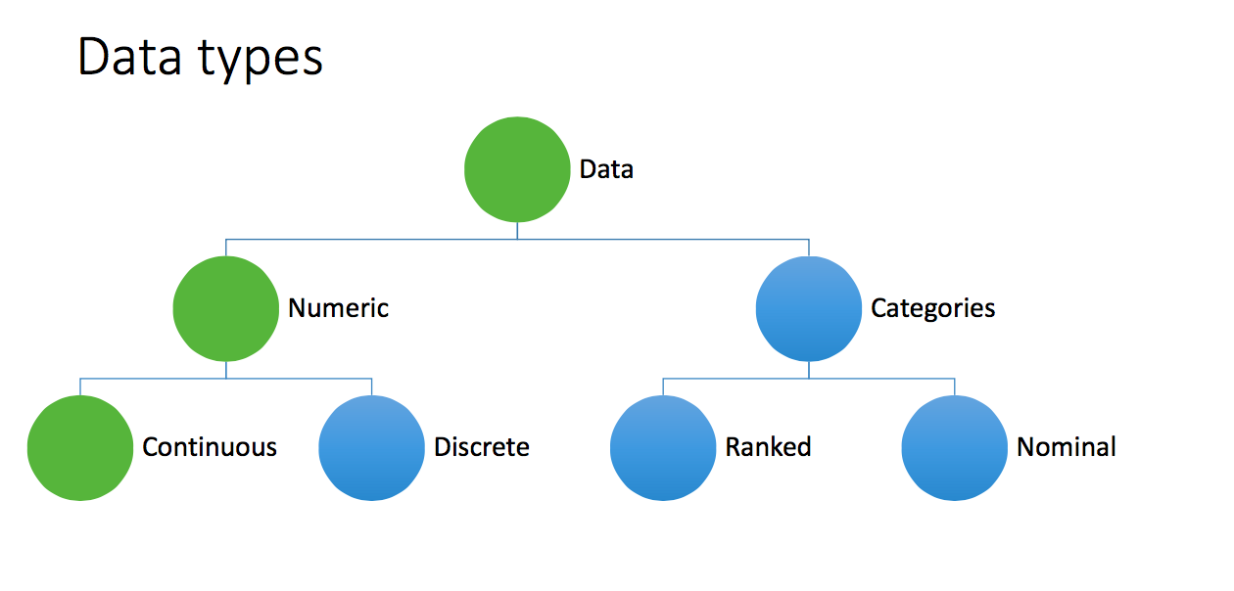
Linear models – different predictors
lm(response~explanatory)

Slide 5
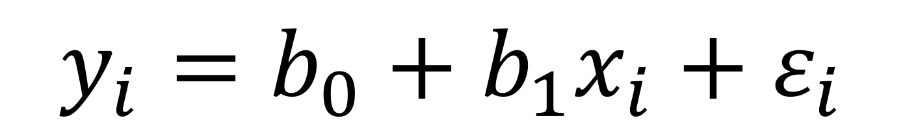
Categorical predictor
Response y:
Continuous
Explanatory x:
Continuous (tarsus, wing, mass)
Categorical (Sex, Year, Observer, BirdID)
lm(response~explanatory)
$$y_{i}=b_{0}+b_{1}x_{i}+ε_{i}$$
Male
Female
Female
Female
Male
Male

Slide 6
Categorical predictor
Response y:
Continuous
Explanatory x:
Continuous (tarsus, wing, mass)
Categorical (Sex, Year, Observer, BirdID)
lm(response~explanatory)
$$y_{i}=b_{0}+b_{1}x_{i}+ε_{i}$$
1
0
0
0
1
1

Slide 7
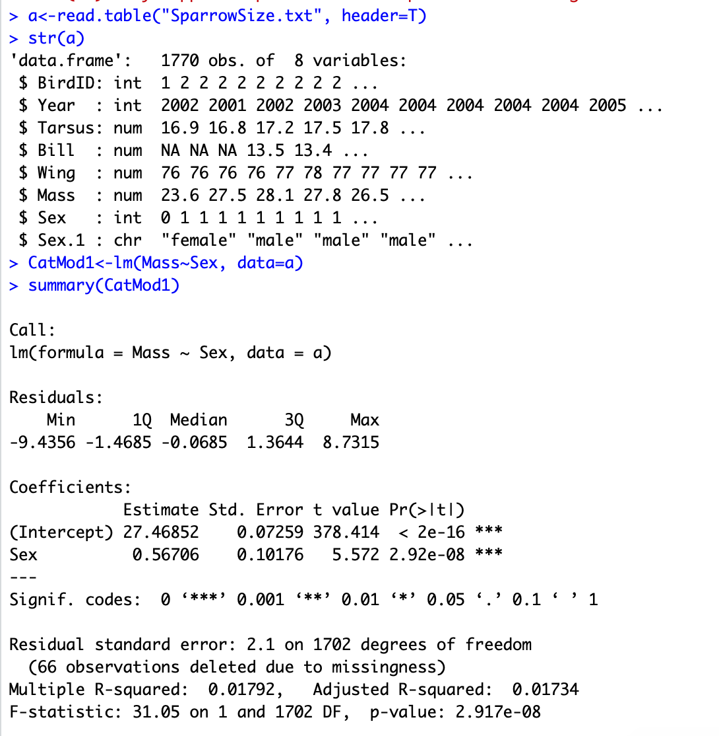
Hypothesis:
Body mass is sexually selected
-> Males predicted to be heavier

Slide 8

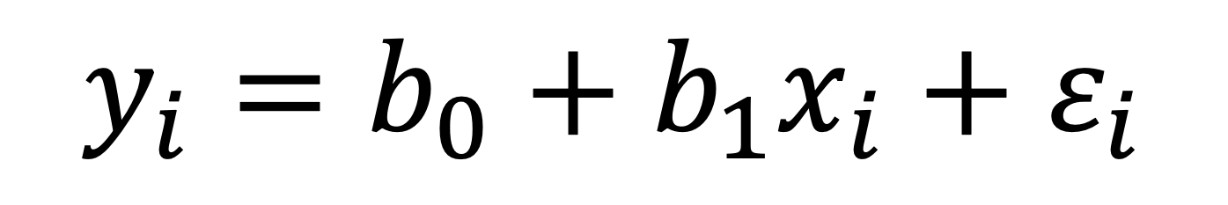



$$y_{i}=b_{0}+b_{1}x_{i}+ε_{i}$$
0
1
1
1
0
…
…
23.6
27.5
28.1
27.8
26.5
…
…
$$y_{i}=b_{0}+b_{1}x_{i}+ε_{i}$$
$$y_{i}=b_{0}+ε_{i}$$
X_{i} = 0
$$y_{i}=b_{0}+b_{1}+ε_{i}$$
$$y_{i}=b_{0}+b_{1}x_{i}+ε_{i}$$
X_{i} = 1

Slide 9


$$y_{i}=b_{0}+b_{1}x_{i}+ε_{i}$$
0
1
1
1
0
…
…
23.6
27.5
28.1
27.8
26.5
…
…
$$y_{i}=b_{0}+ε_{i}$$
X_{i} = 0
Intercept
$$y_{i}=b_{0}+b_{1}+ε_{i}$$
X_{i} = 1
Intercept + sex estimate

Slide 10
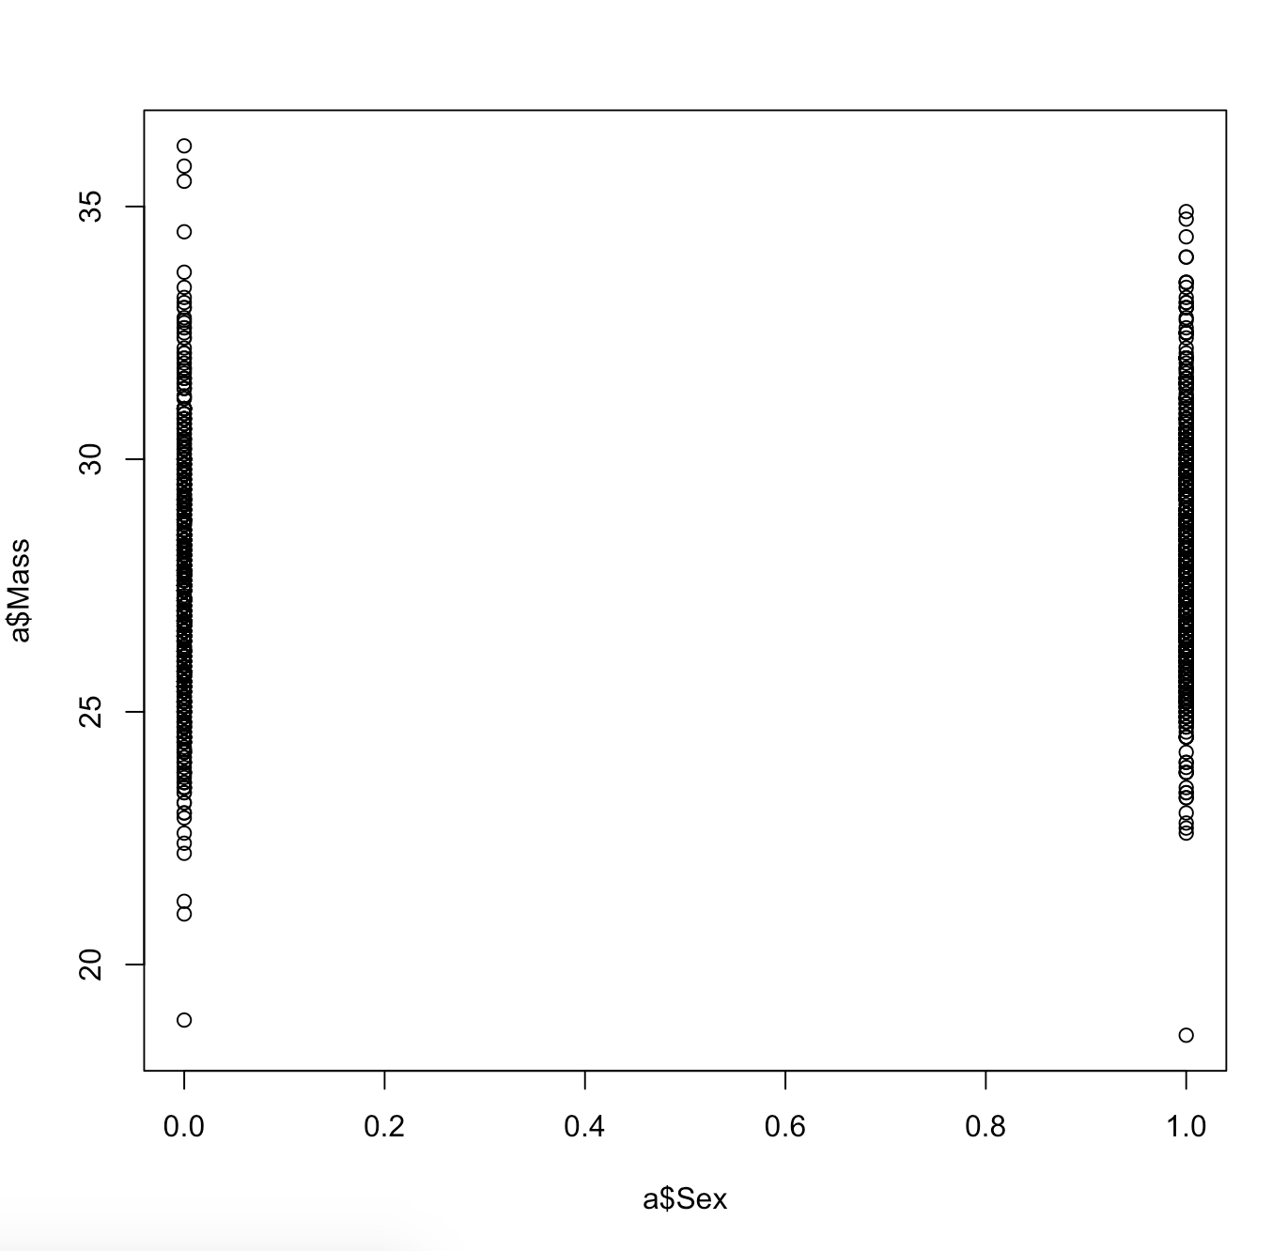
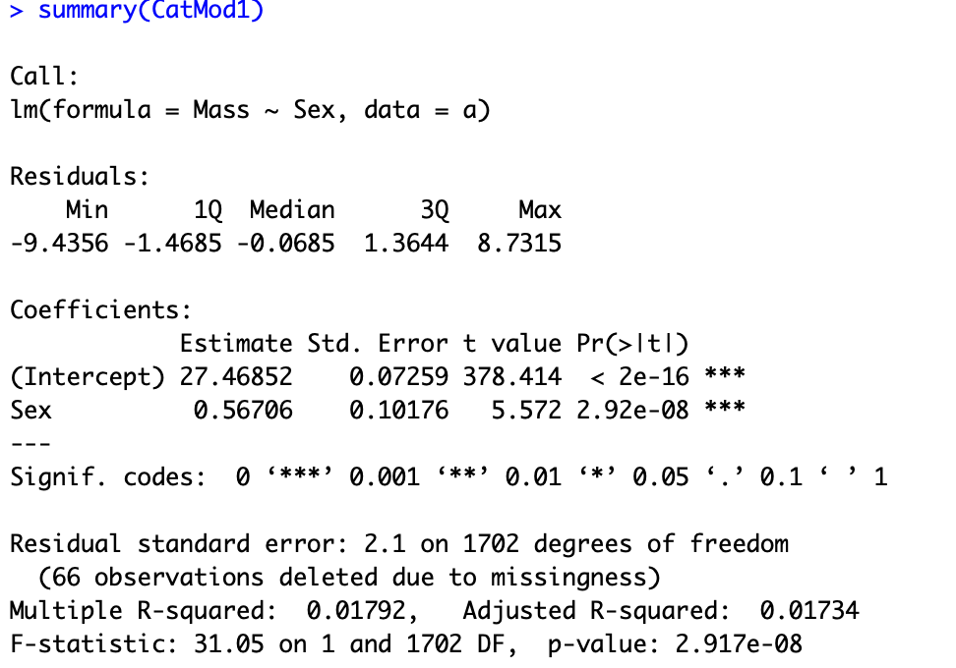


Slide 11
Means of each group:
Intercept = mean of x = 0
Intercept + b₁ = mean of x =1

Slide 12
Means of each group:
Intercept = mean of x0 = 27.47
Intercept + b₁ = mean of x1 = 28.02

Slide 13
Means of each group:
Intercept = mean of x0 = 27.47
Intercept + b₁ = mean of x1 = 28.02
b₁ = difference between both groups

Slide 14
Categorical predictors:
Intercept is mean of reference category
Categorical predictor is difference to reference category
Means of each group:
Intercept = mean of x0 = 27.47
Intercept + b₁ = mean of x1 = 28.02
b₁ = difference between both groups

Slide 16
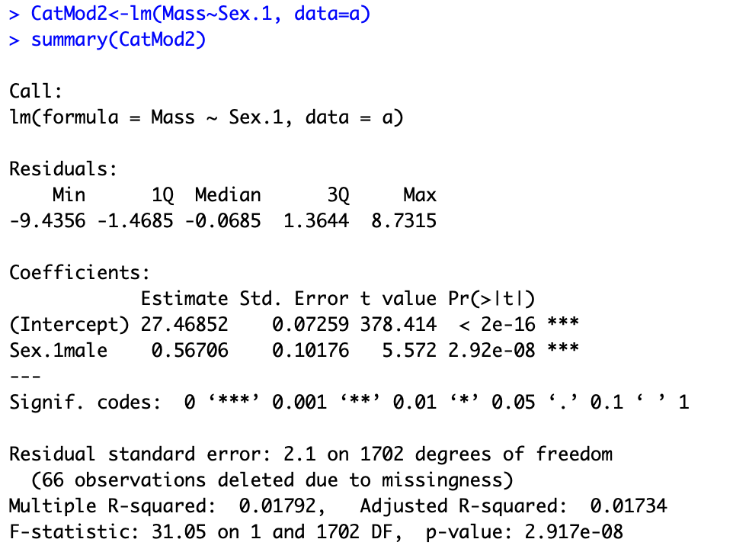
R choose the reference category alphanumerically
and uses internal dummy codes:
Female = 0
→ Male = 1

Slide 17
Categorical predictors
But what about categorical predictors with more than two levels?

Slide 18
Year as categorical predictor
Hypothesis:
Different years have different food supply
Prediction:
Mass differs between years

Slide 19
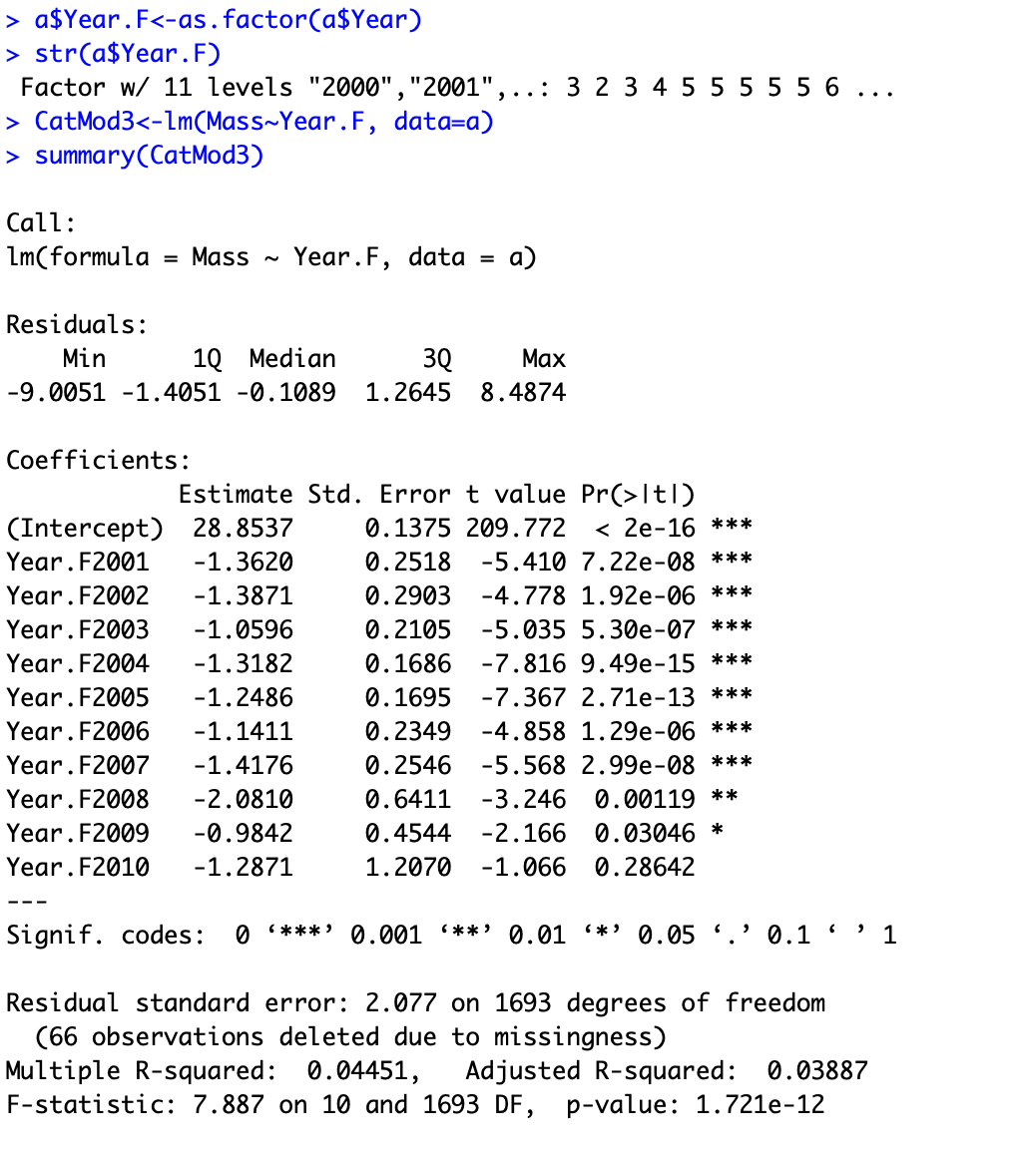

Slide 22
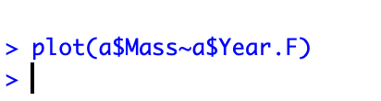
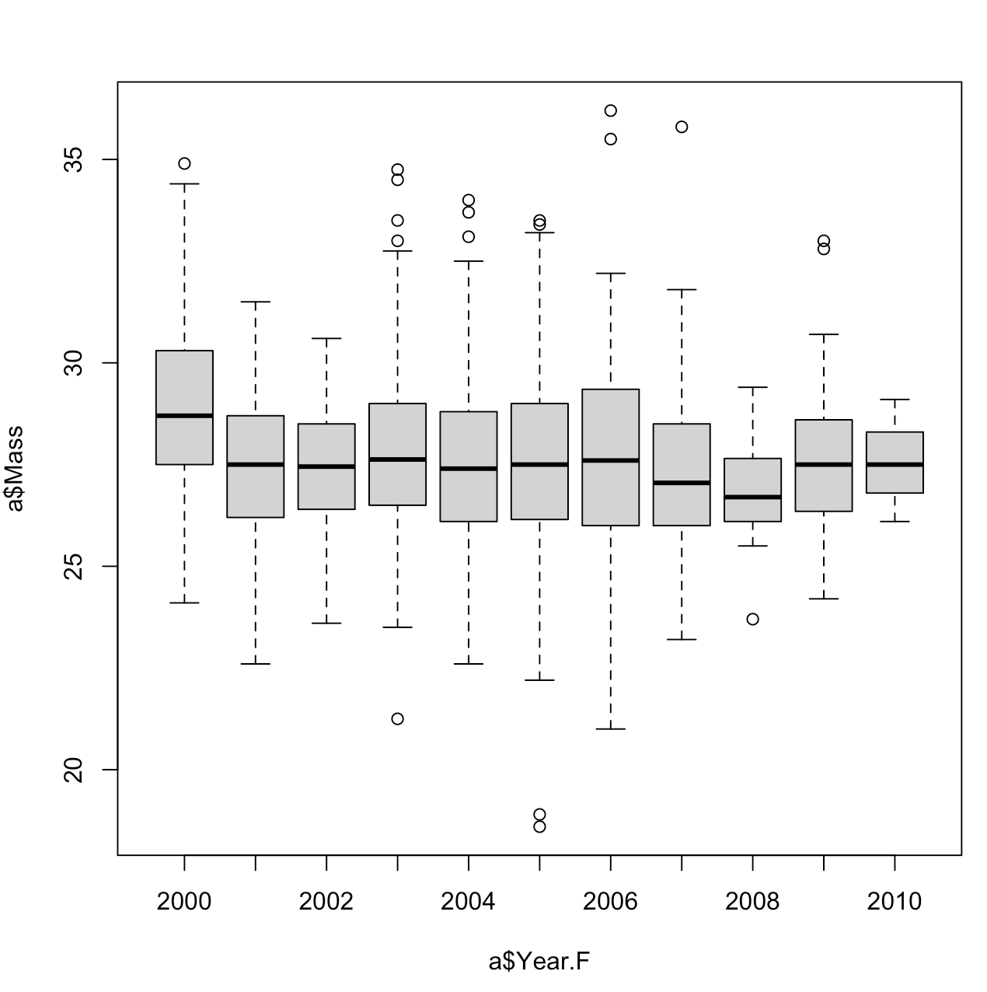

Slide 23
2000 is the reference level
-> 2000 is the intercept – 28.85
-> 2001 is the intercept + 1.36

Slide 24
2000 is the reference level
-> 2000 is the intercept – 28.85
-> 2001 is the intercept - 1.36
-> 2002 is the intercept - 1.39
-> 2003 is the intercept – 1.06

Slide 25
2000 is the reference level
-> 2000 is the intercept – 28.85
-> 2001 is the intercept - 1.36
-> 2002 is the intercept - 1.39
-> 2003 is the intercept – 1.06

Slide 26
Take home: categorical predictors:
R chooses reference level alpha-numerical
Intercept = mean at reference level
Estimates: = difference to reference level
T-test: difference to reference level
Using categorical variables with many levels – not so good because loosing lots of d.f.s

